Slide 1

Welcome To Gomla Market
Report for Dashboard Analysis

Slide 2
Report including
Purpose: Provide a quick overview of branch and sales performance for the period
Contents: Includes KPIs, Top/Bottom Performance, Branch Insights, Sales Trends

Slide 3
KPIS Dashboard
1
2
3
4
Total Sales
2253 M
Total Quantity
65 M
Avg-Sales
5K
Count of Branches
52
.
5
Count of Sections
33
.

Slide 4
Charts Report

Slide 7
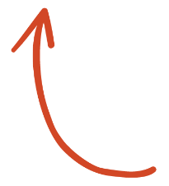
SELECT ME

Slide 8


Slide 9
Suggestion For Next Phase
Increase in the number of branches in Mansoura and Manzla
Increase in staff at the Mansoura and Manzla branches to better assist customers.
Increase in products in the canned goods, local butcher/meat, and cleaning supplies sections.
“Increase in advertisements and special offers at the Green Towers and Tery Mansoura branches to attract customers.”
“Reduced stock of low-profit products such as Fragolo jam and wooden massage tools.”

